Slide 1

Psychological Measurement – Workshop 1

Slide 2

Today’s Session
Hour 1:
Consider how we group behaviours
Consider how we ascribe behaviours to attributes
Think of situations in which we might categorise people based on behaviours
Think of the types of labels we attach to behaviours
Hour 2
Complete a fun(ish) online personality questionnaire
Interpret and critically evaluate the feedback
Open Jamovi

Slide 3
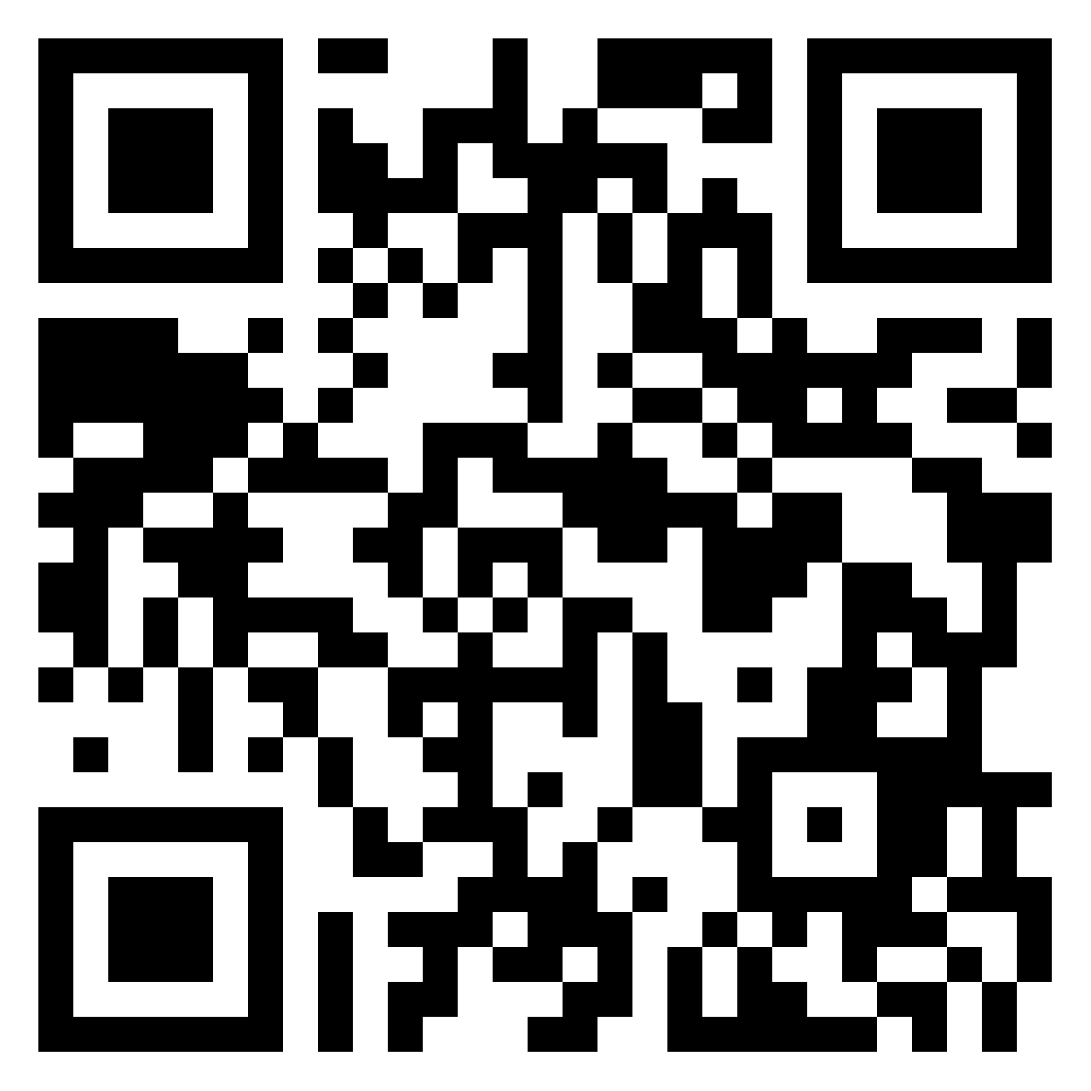
But First - Reflections
Something you’ve learned
Something you’ve enjoyed
Something you’ve found challenging
tinyurl.com/3k6yxs6y
Group 1

Slide 4
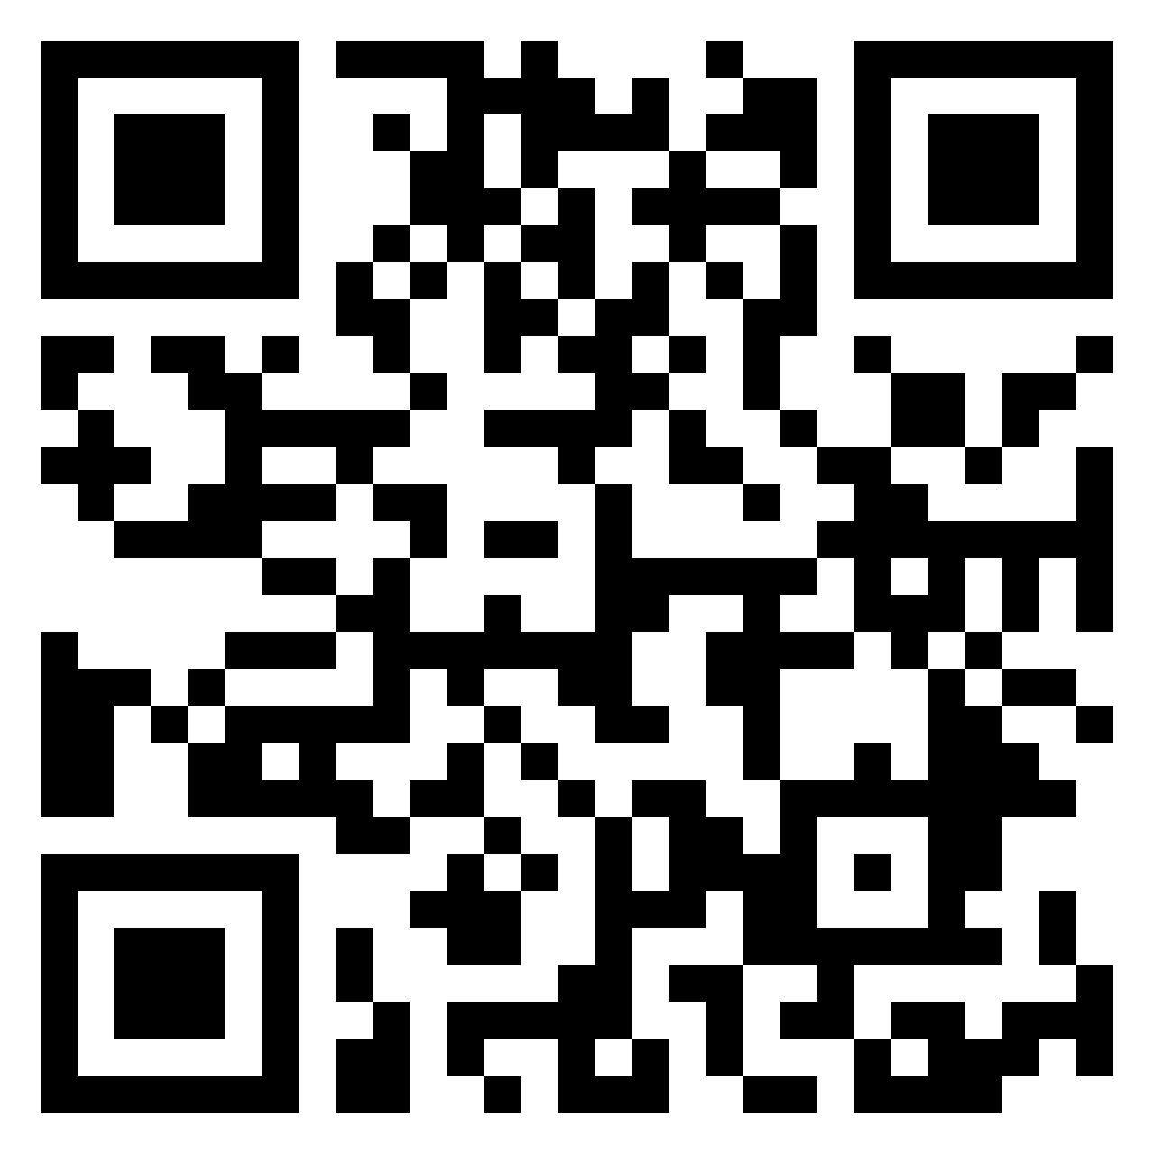
But First - Reflections
Something you’ve learned
Something you’ve enjoyed
Something you’ve found challenging
tinyurl.com/hjbynnnw
Group 2

Slide 5
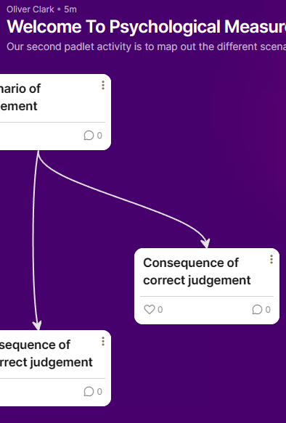
Activity 1 – 20 minutes
In what scenarios might we judge people based on their behaviours?
What might the consequences of:
Correct judgement
Incorrect judgement

Slide 6
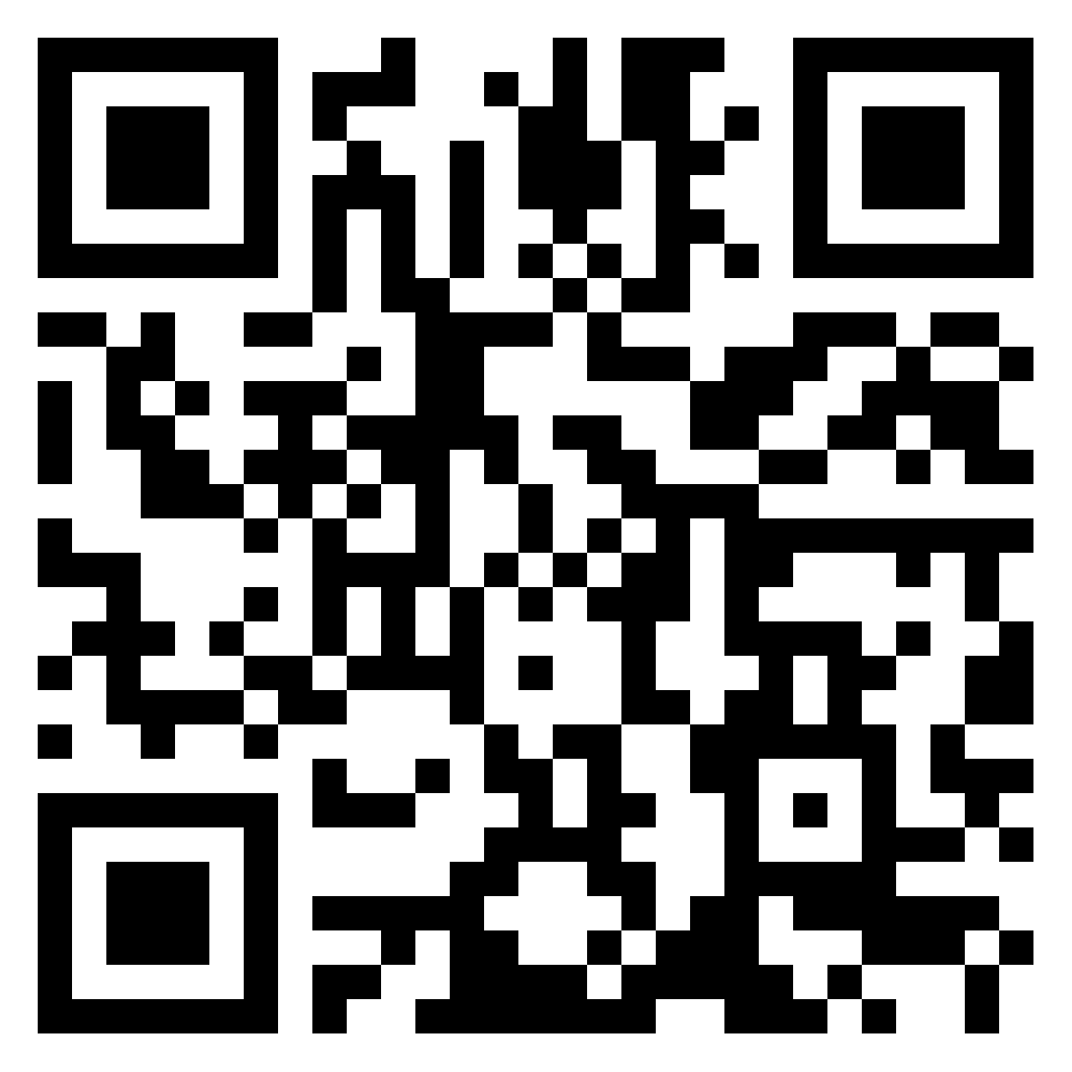
Padlet
Scan QR Code ->
Or Click:
Padlet Link
Or Type
tinyurl.com/2cun7jmj

Slide 7
Categories of People
Last week you completed an online questionnaire which gave you feedback based on your personality profile
You critically evaluated this
Apply similar arguments to the judgement scenarios you have just identified.
Be prepared to feed back

